Slide 1
Data Engineering Case Study
Dec 2025

Slide 2
Functional Requirements - The organization wants to modernize its data infrastructure to support real-time analytics, compliance, and reporting. You are tasked with designing and implementing a robust, scalable ETL pipeline that ingests, processes, validates, and stores trade data using cloud-native tools.
Detailed Requirement Specifications –
Data Ingestion
Simulate trade data generation (using a script or a mock service).
Publish trade events to a messaging system (e.g., Google Pub/Sub or Kafka).
Data Processing and Validation-
Use a data processing engine (e.g., Google Dataflow, Dataproc, or Data Fusion) to consume trade events from Pub/Sub and apply business logic
Data Storage-
Store valid trades in a cloud data warehouse (e.g., Snowflake, BigQuery).
Store rejected trades in a separate table for compliance
Orchestration and Monitoring-
Use Airflow/Composer to orchestrate the ETL workflow
Schedule jobs, monitor pipeline and implement alerting
Create Dashboard to visualize trade status

Slide 3
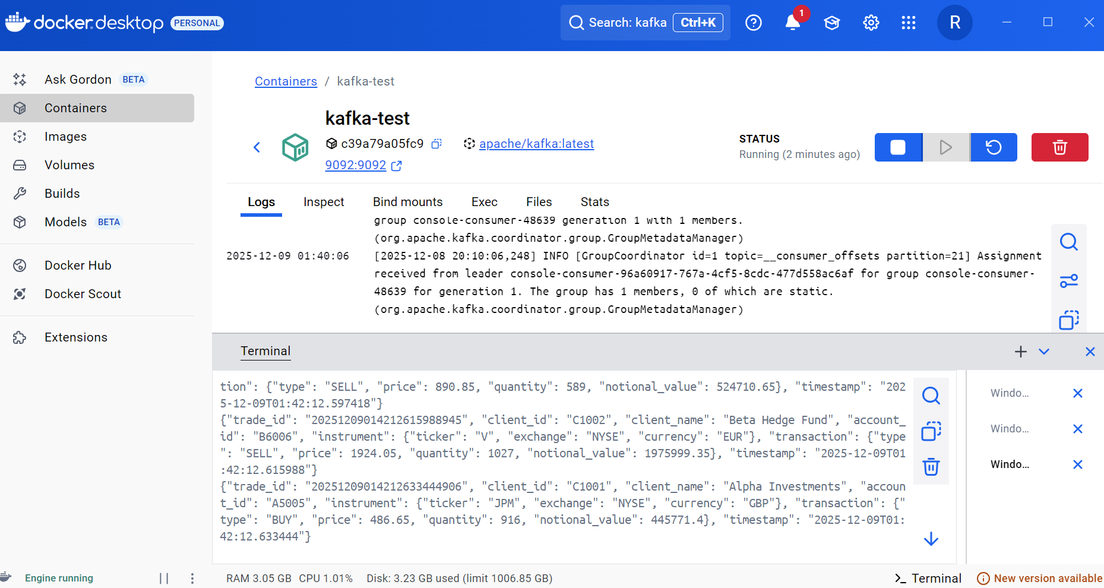
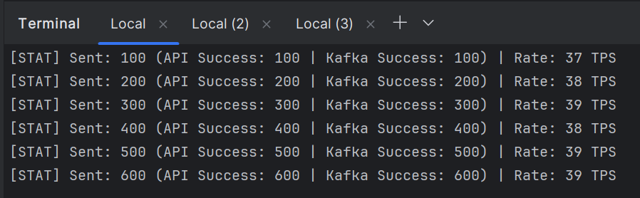
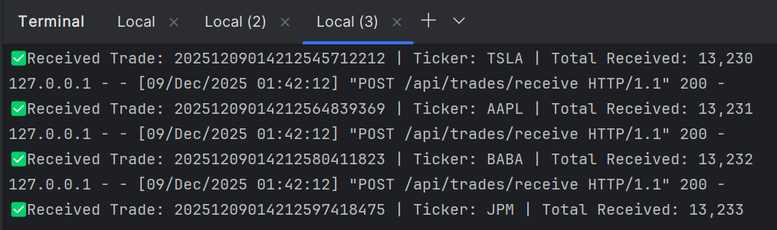
Step 1 - Data Ingestion
Developed mock trade simulation script in Python/Flask using Pycharm
The Trade message/payload has client id and trade detail information like
TICKERS = ['AAPL', 'GOOGL', 'MSFT', 'META', 'BK', 'AMZN', 'TSLA', 'NVDA', 'JPM', 'V', 'BABA', 'WMT']
TRADE_TYPES = ['BUY', 'SELL’], CURRENCIES = ['USD', 'EUR', 'GBP’], EXCHANGES = ['NASDAQ', 'NYSE', 'LSE']
MATURITY_DATE,VERSION
MOCK_CLIENTS = [
{'client_id': 'C1001', 'account_id': 'A5005'},
{'client_id': 'C1002', 'account_id': 'B6006’}]
Program sending messages to Kafka queue and API endpoint
Created Kafka Queue using Docker Desktop and Image

Slide 4
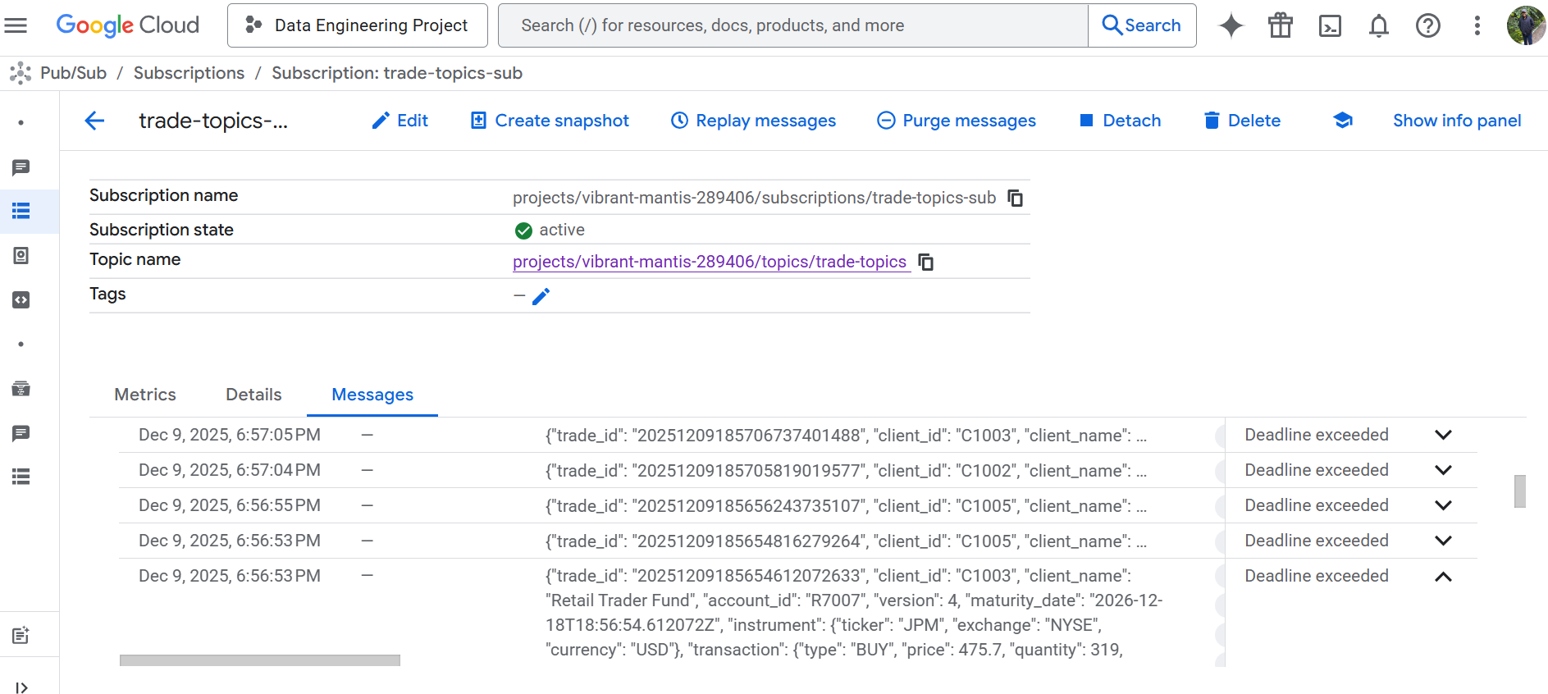
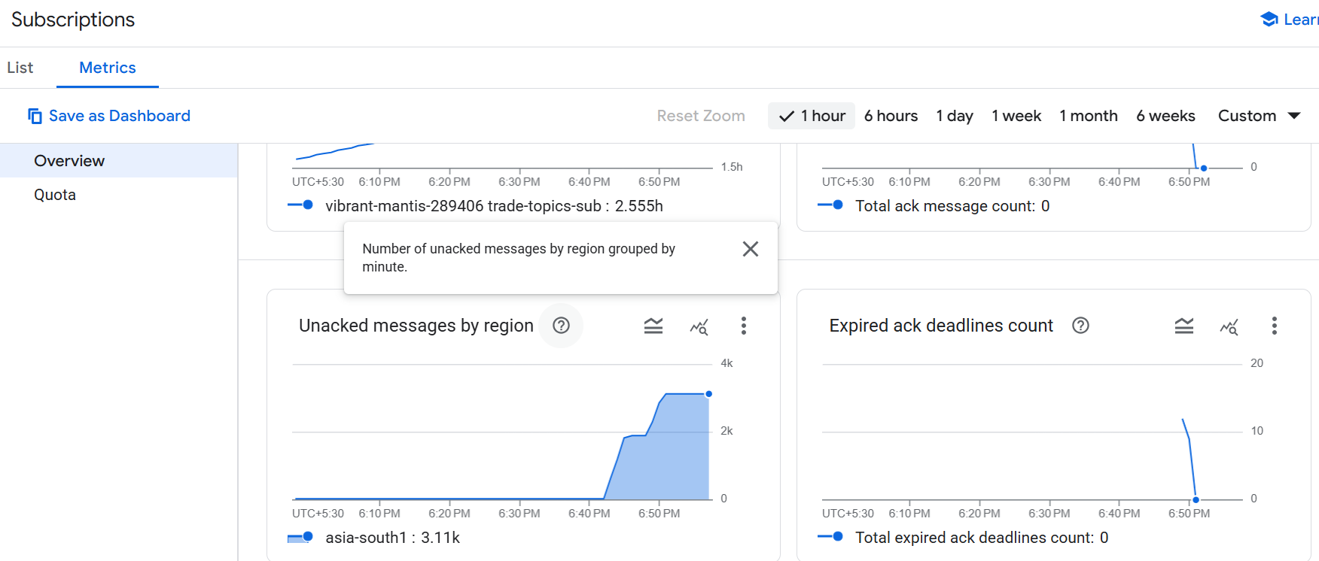
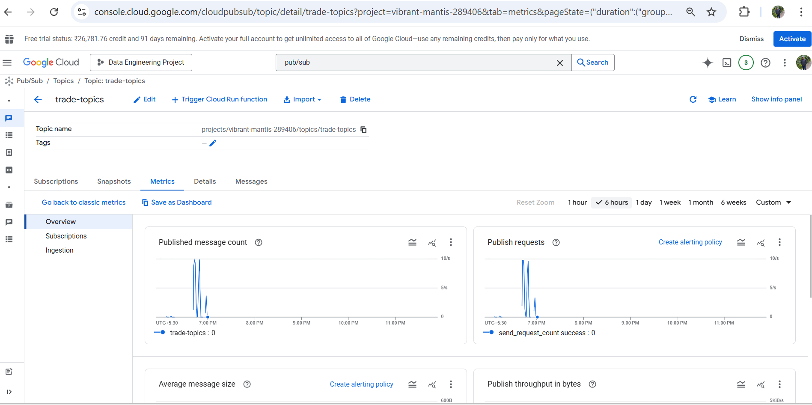
Step 1 - Data Ingestion contd
Next iteration, Loaded Trades into the GCP Pub/Sub Queue. Observed latency from local desktop to GCP Pub/Sub
Trades loaded successfully into GCP Pub/Sub Topic

Slide 5
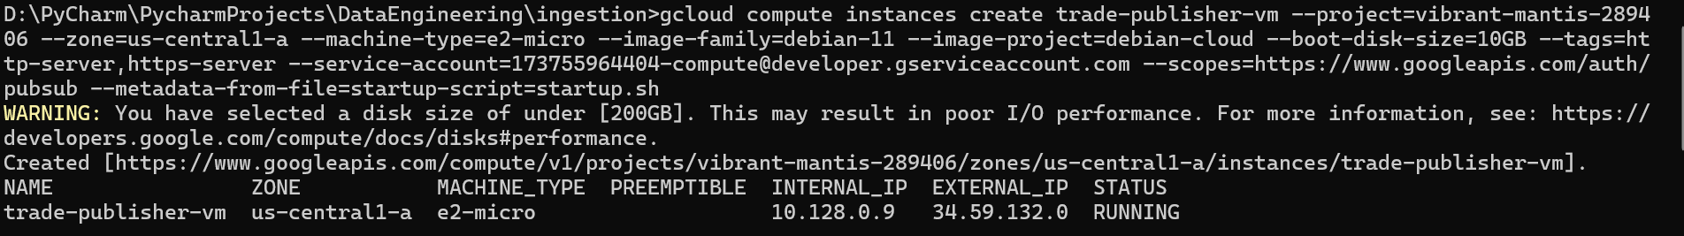
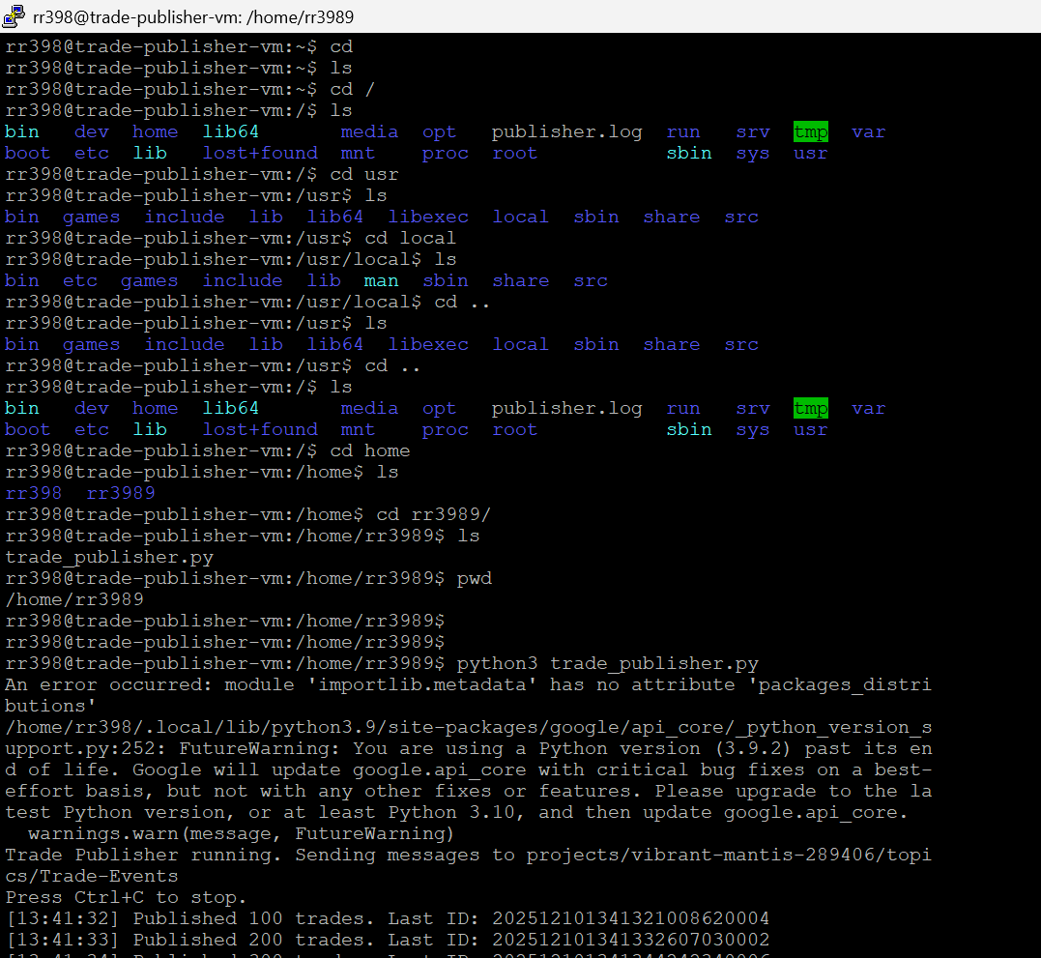
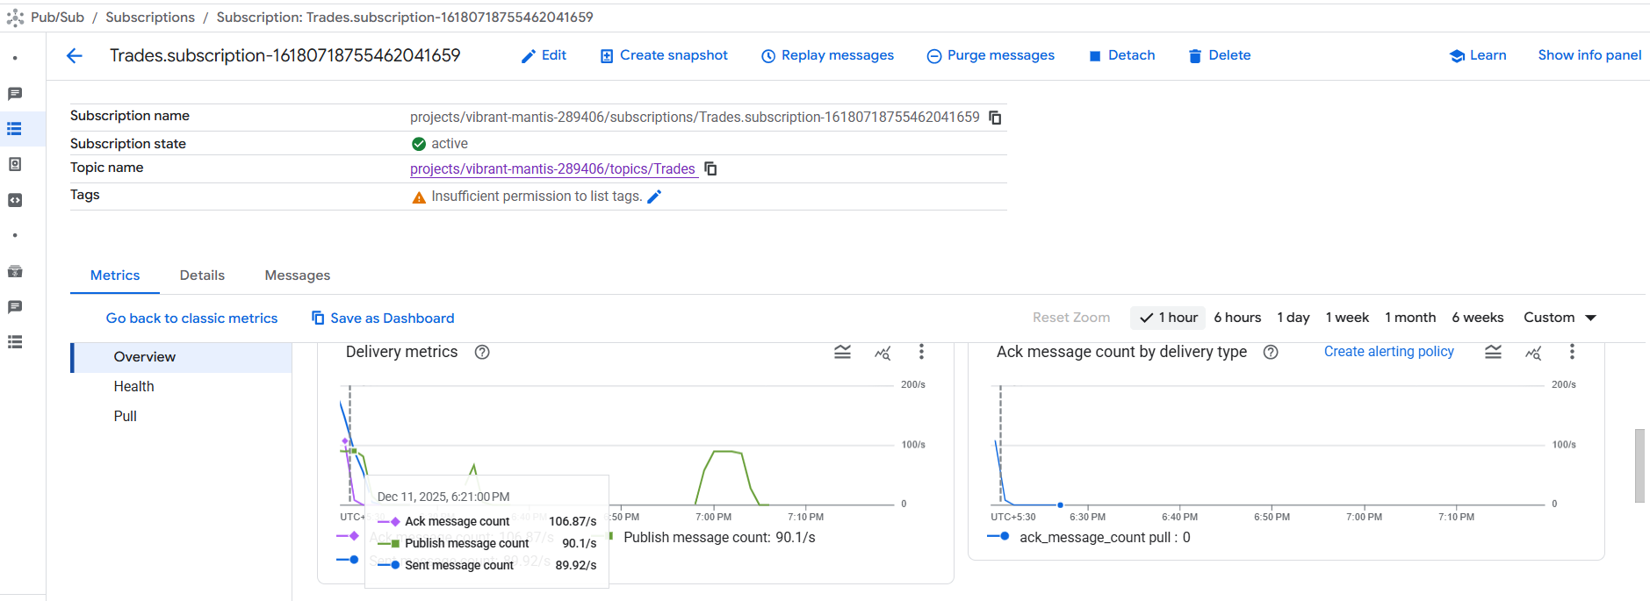
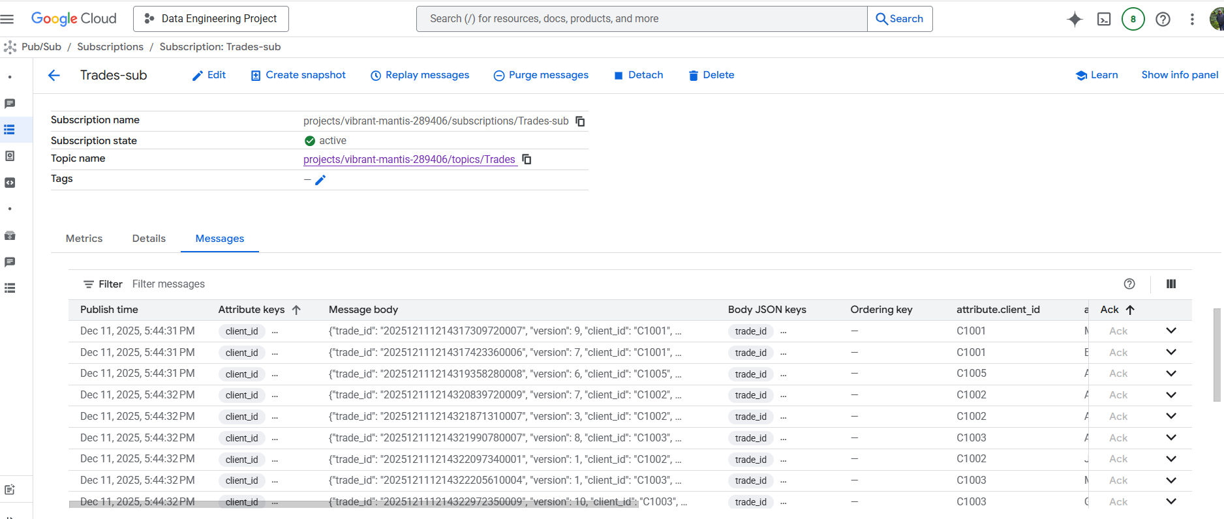
Step 1 - Data Ingestion contd
As the network latency was high, moved the python code to GCP VM container in the same us-central region
Created new topic – Trades. The latency to load into the Pub/Sub queue reduced significantly as the messages originated from the same region
Pulled and displayed messages in the queue – successful transmission of trades

Slide 6
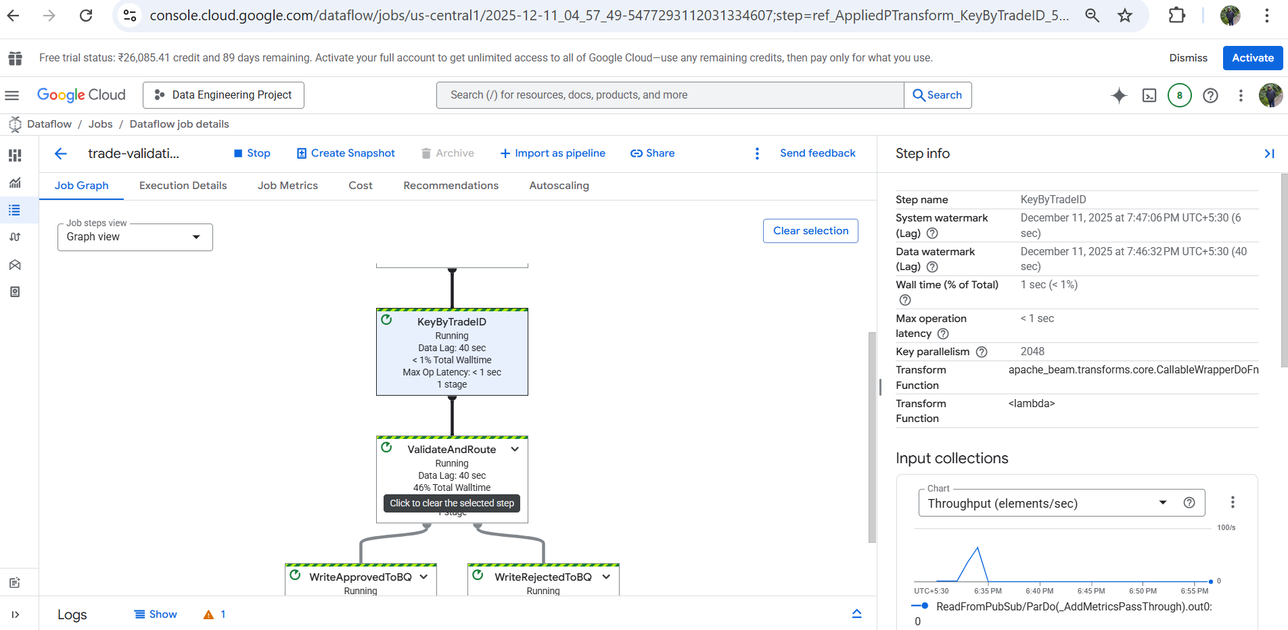
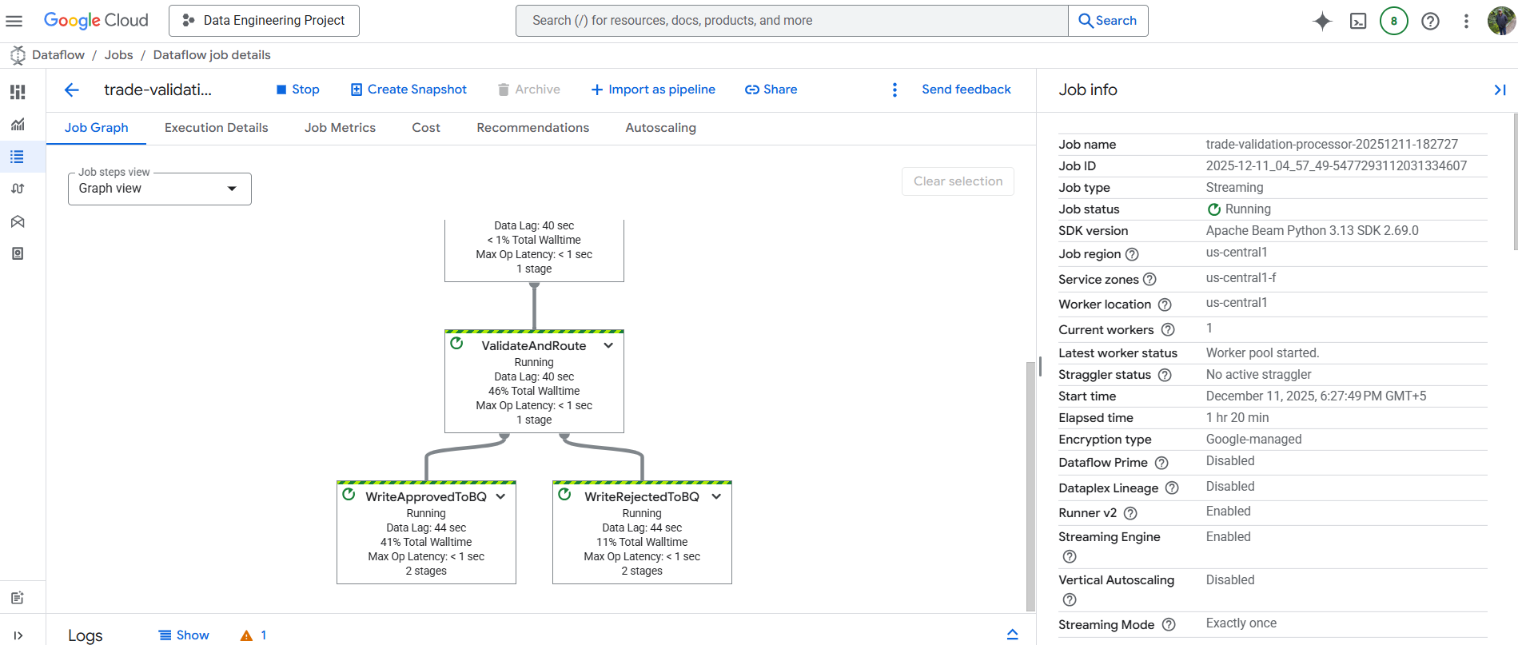
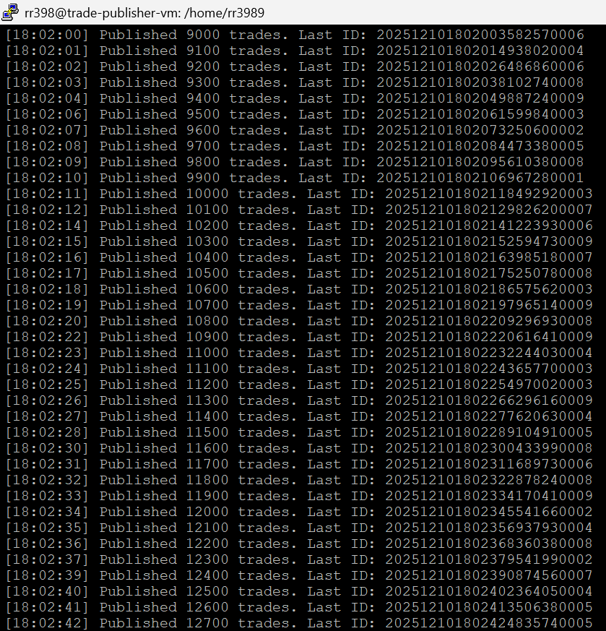
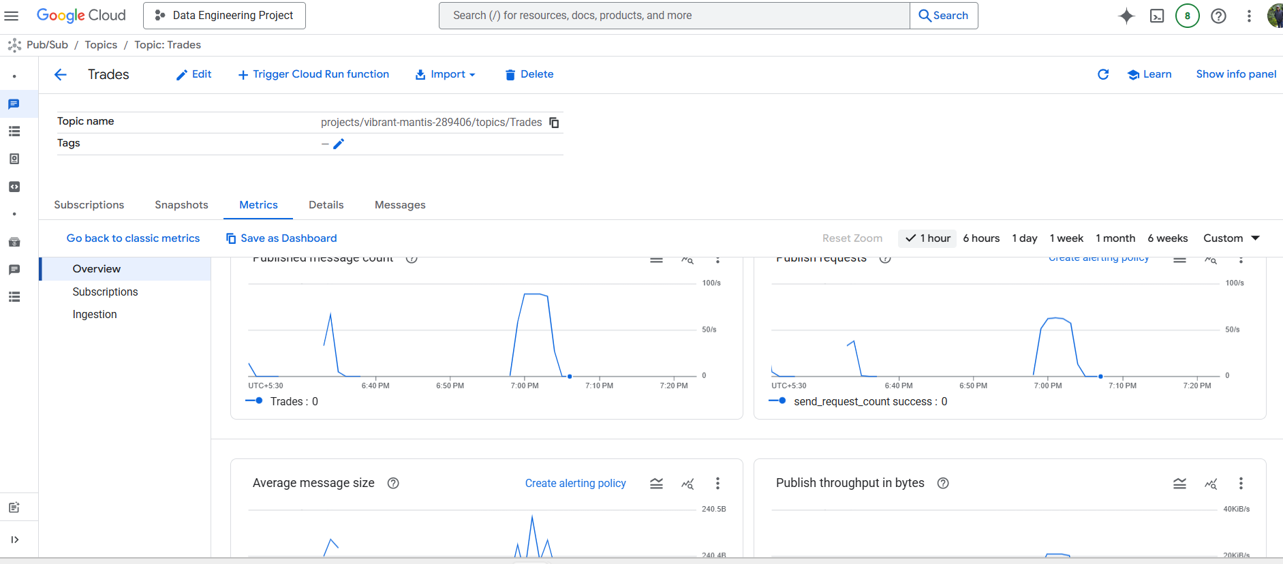
Step 2 - Data Processing and Validation
GCP Dataflow job created and pipeline pulling trades from Pub/Sub
Applied Business Rules for version check and maturity date
Trades being published from the VM and sent to the Trades PUB/SUB on GCP

Slide 7
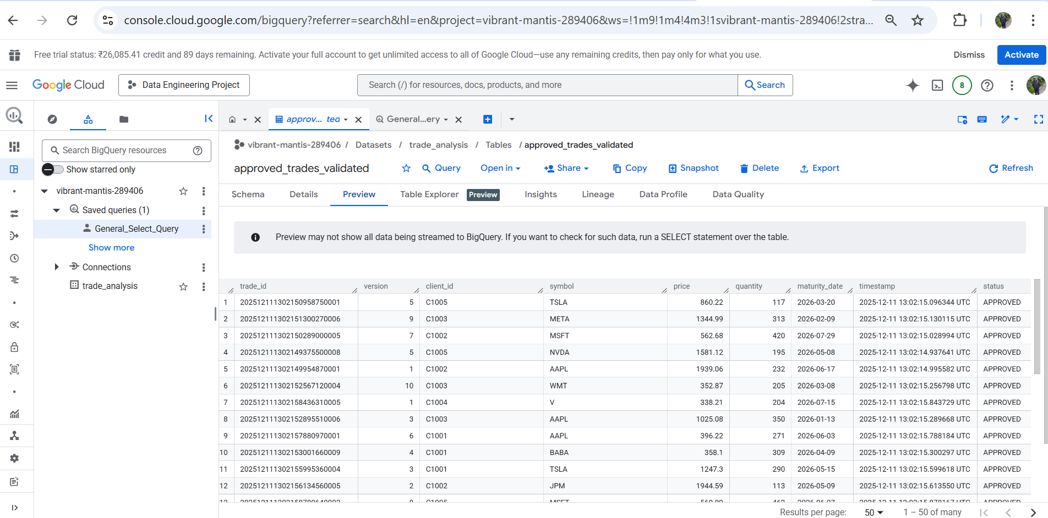
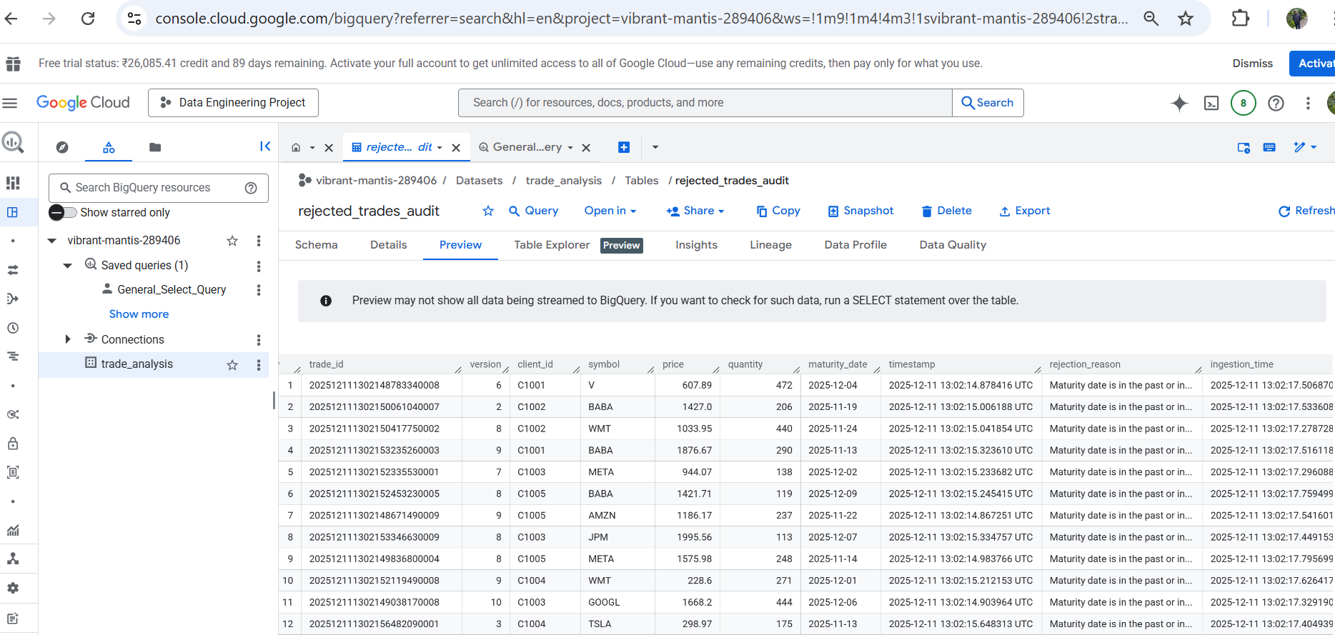
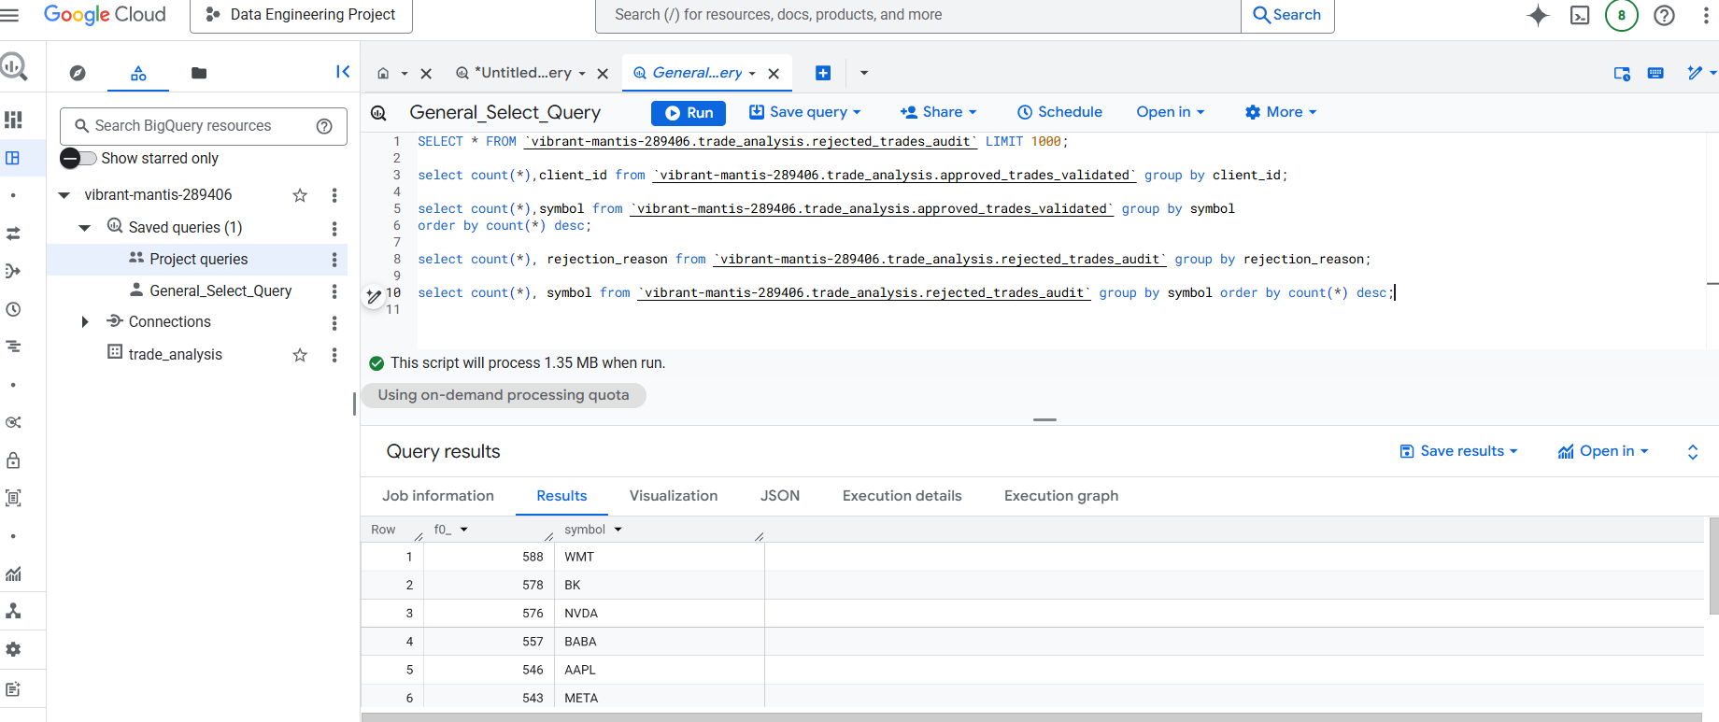
Step 3 - Data Storage
Created Dataset trade_analysis in BigQuery
Schema for both tables was replicated/created from the trades JSON to the table structure
Additional columns like rejection_reason was added to the rejection audit table
Valid trades stored in BigQuery Table - approved_trades_validated
Stored rejected trades in BigQuery Table rejected_trades_audit
Created General Queries to check for counts and aggregates

Slide 8
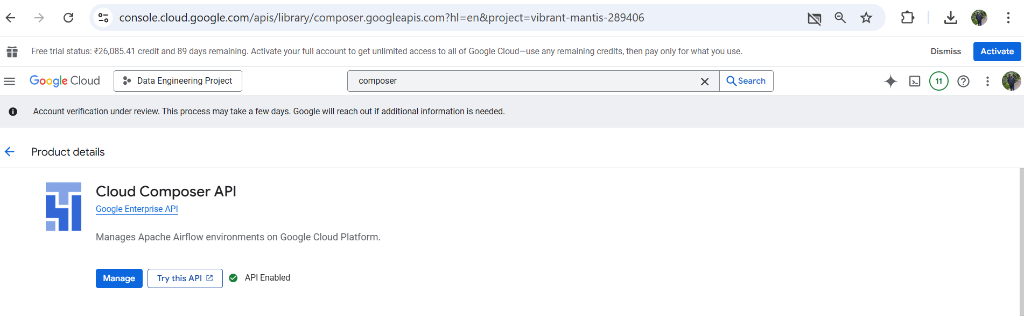
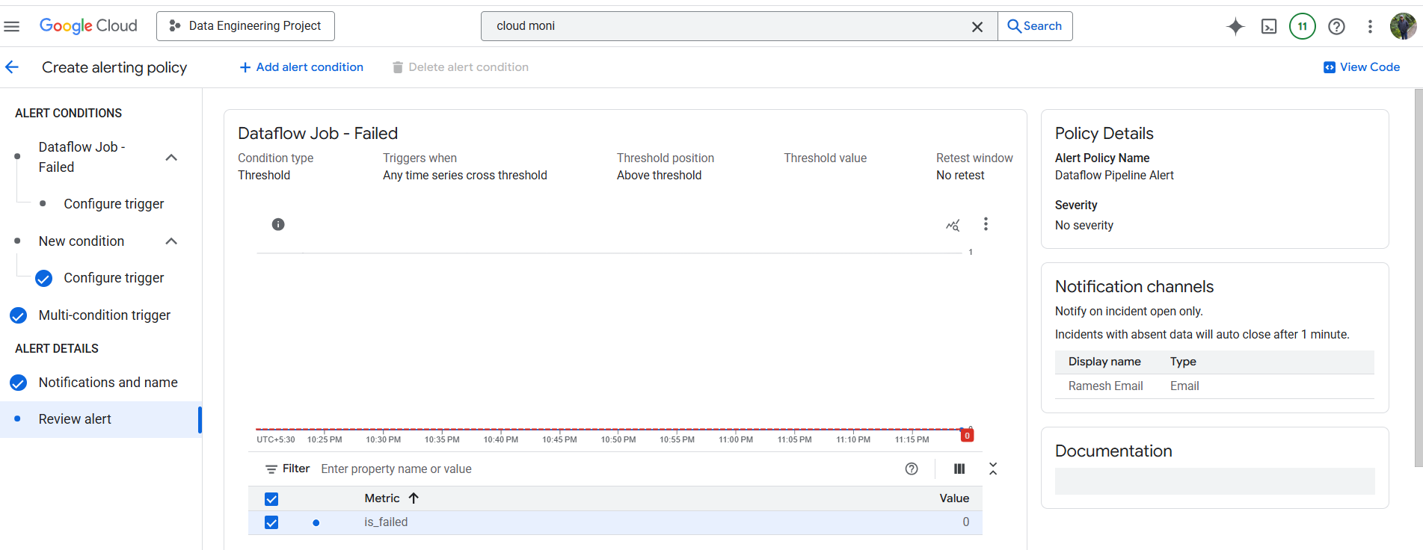
Step 4 – Orchestration and Monitoring
Airflow/Composer was not available as a service due to account verification process
Created a basic email alert notification mechanism based on pipeline failures.

Slide 9
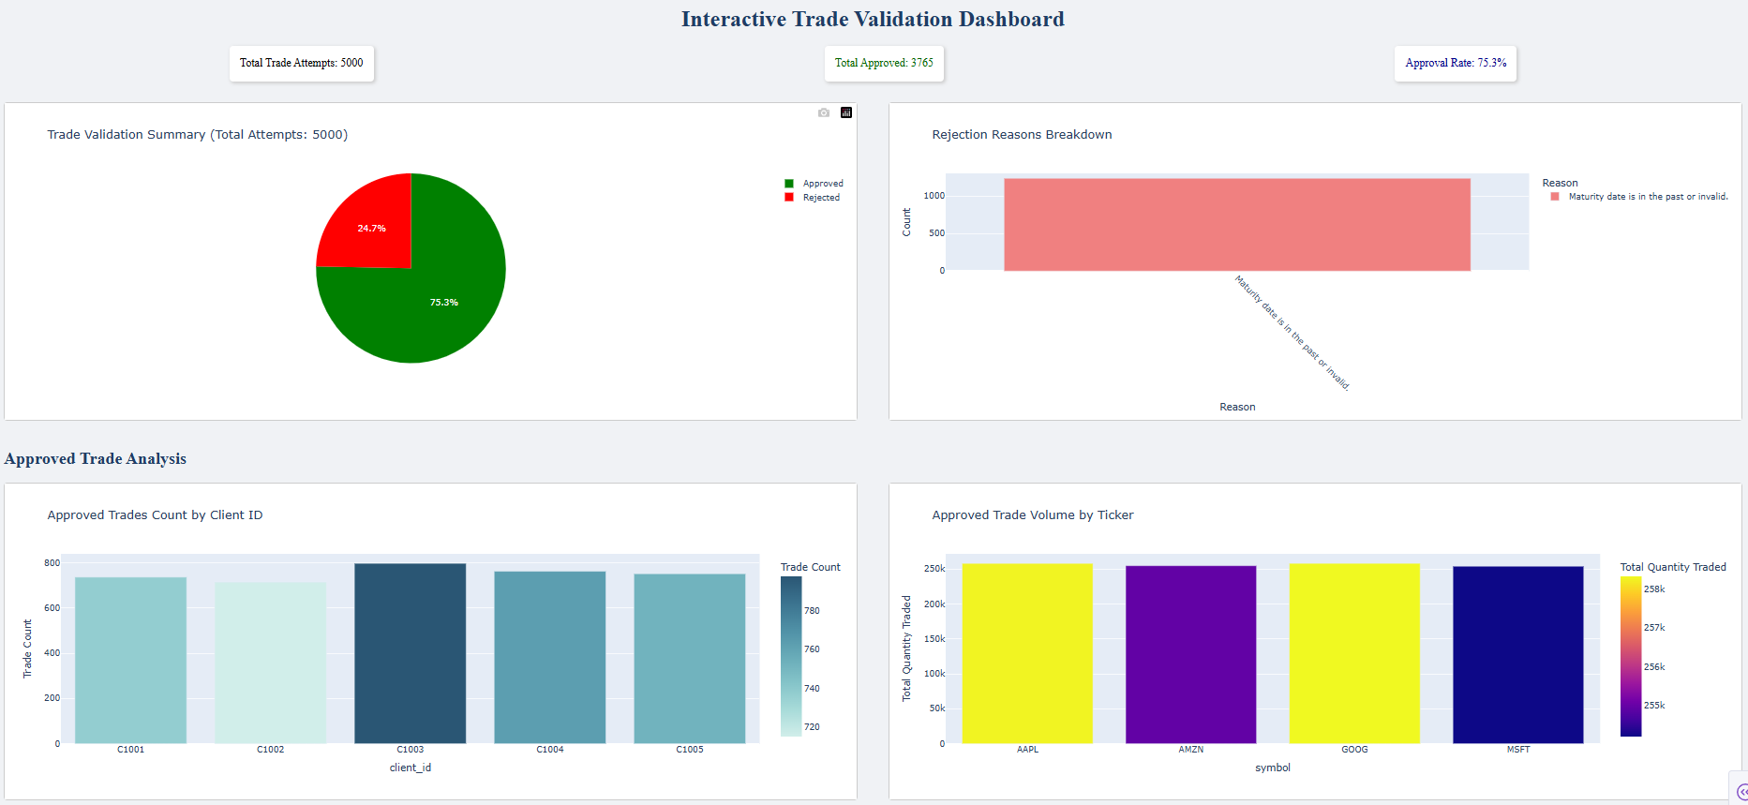
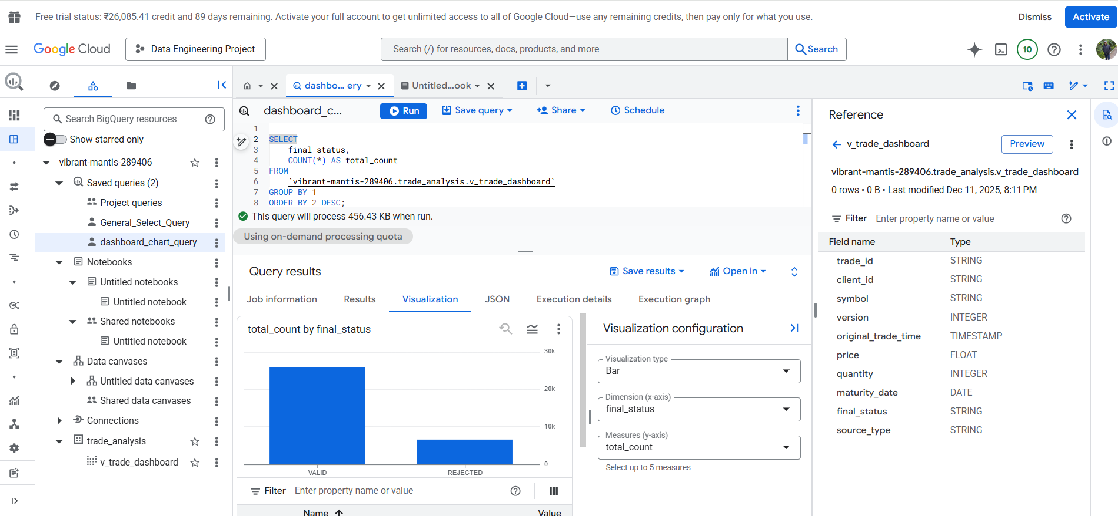
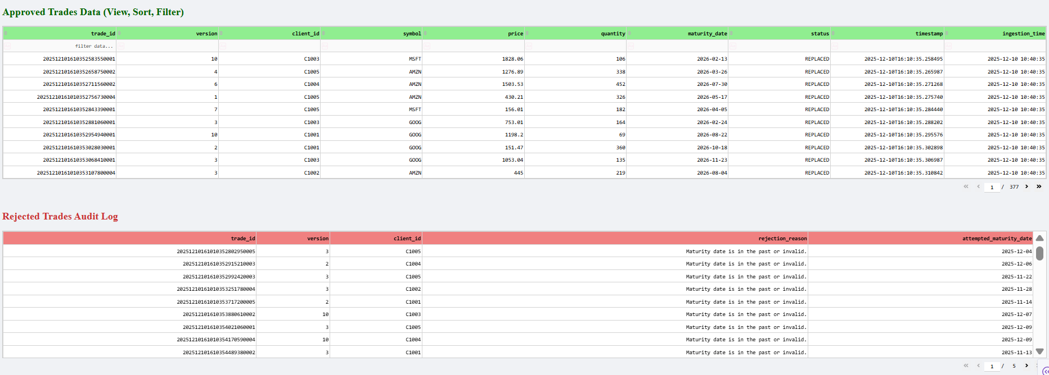
Step 5 – Dashboard
Before even moving to GCP, stored the data locally in SQLLite DB as backup to start and used python (matplotlib) to visualize trades and generate charts
The below chart was visualized in GCP using charts to avoid looker studio and others.

Slide 10
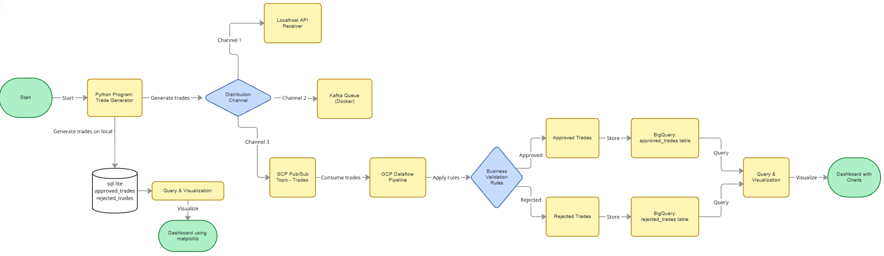
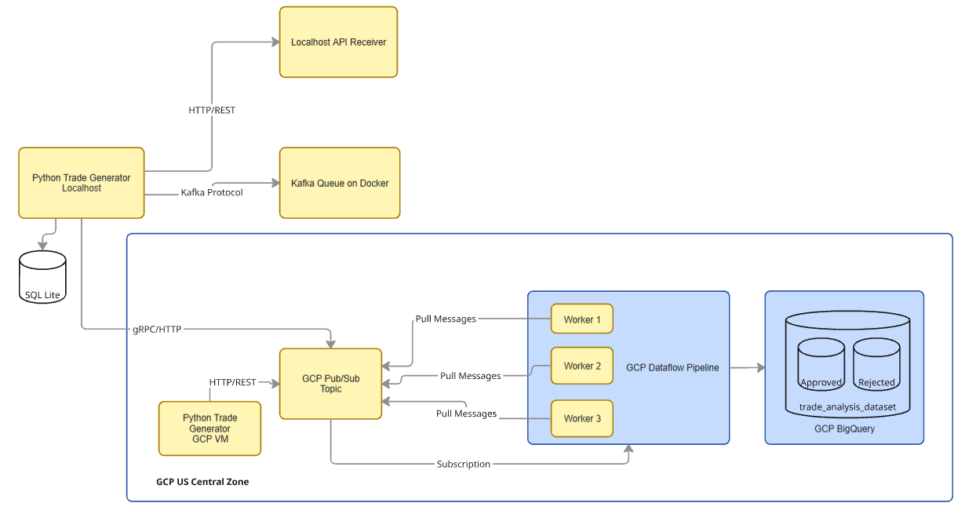
Data Process Flow and Architecture Diagram
Created the below Process flow to depict various steps from Data Creation, Ingestion, Validation and Storage
Architecture diagram showing the GCP region and connection between each component

Slide 11
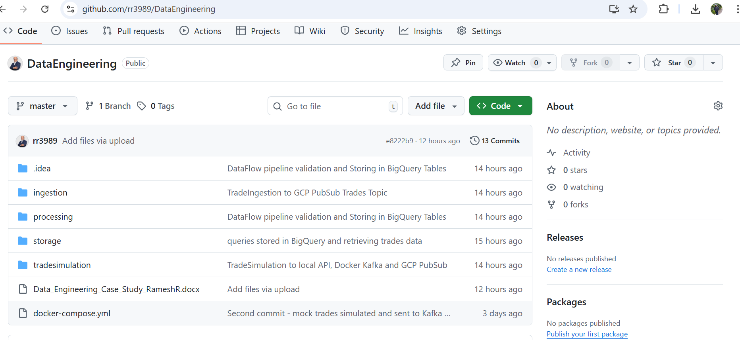
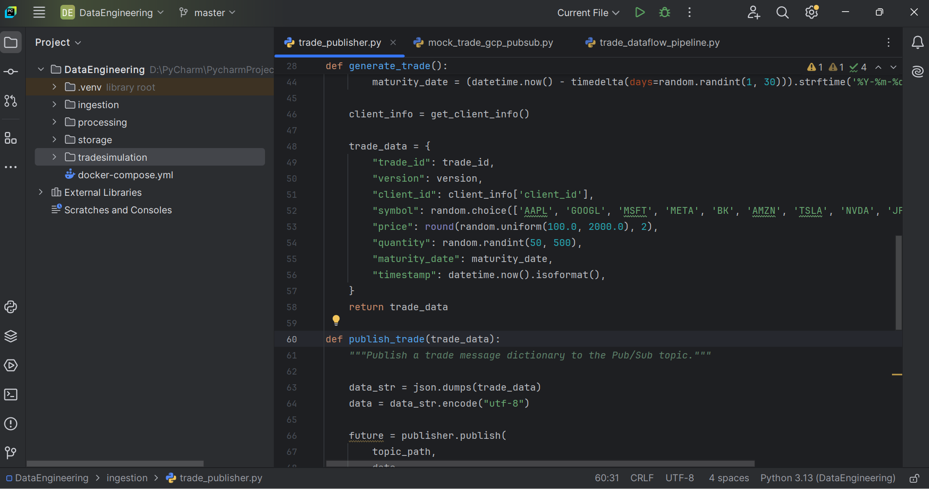
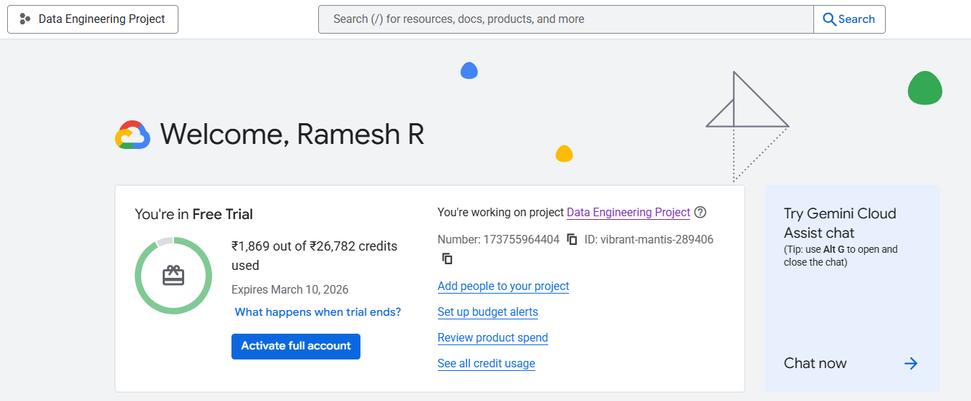
The code for the project has been stored in the below GITHUB location
https://github.com/rr3989/DataEngineering
Google Cloud Project - Data Engineering Project
Google account – RR3989@gmail.com
Project Number - 173755964404
Project iD - vibrant-mantis-289406

Slide 12
Thank You

